Slide 1
What is AJAX?
AJAX = Asynchronous JavaScript And XML.

Slide 2
Use of Ajax
AJAX allows web pages to be updated asynchronously by exchanging data with a web server behind the scenes. This means that it is possible to update parts of a web page, without reloading the whole page.

Slide 3
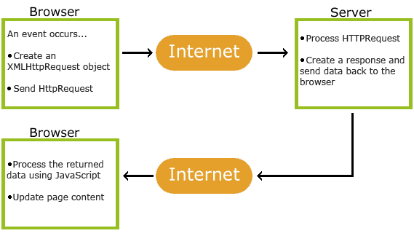
How AJAX Works

Slide 4
How AJAX Works
1. An event occurs in a web page (the page is loaded, a button is clicked)
2. An XMLHttpRequest object is created by JavaScript
3. The XMLHttpRequest object sends a request to a web server
4. The server processes the request
5. The server sends a response back to the web page
6. The response is read by JavaScript
7. Proper action (like page update) is performed by JavaScript

